Slide 1
AUTOMATIC ELEVATOR CONTROL SYSTEM
Github Link
SE Mini Project Group-8

Slide 2
Group Members (Group 8)
Abhinandan : IIT2020119
Shivam Harjani : IIT2020121
Aditi : IIT2020138
Kirti : IIT2020142
Shashwat : IIT2020157

Slide 3
Abstract
In this project we have developed a GUI enabled automatic elevator system in the CC3 building. The system functions with the automatic door opening and closing mechanism, and can also detect if the elevator is overloaded and when people exit from the elevator then only the door will close.
People can navigate on the floor and exit or enter on floor of their choice. In case of failure an email or alert should be sent to the admin to make sure that lift reaches at the nearest floor with some power backup and ensure the safety of the people.

Slide 4
Objective
To provide admin an easy interface to manage the elevators
To provide emergency alerts as per the needs of the passengers
To maintain the track of entry and exit on regular basis

Slide 5
Software Requirements
Operating System
Jdk 15.0.1 preferred
Java Swing
Netbeans
Java APIs
There won’t be any hardware requirements as we are dealing solely with tech at present.

Slide 6
Features Implemented
Automatic Opening and Closing of Door.
Door of Lift remain open in case of overload until it is reduced.
Scheduling Algorithm is implemented for simulating the moving elevator which is based on serving requests such that it is the fastest possible route.
In Case of Emergency the Lift stops at the nearest with the help of Power Backup, and also sends an alert to the administrator.
Feature of Emergency Requests, which ignores all other requests in case of an emergency and serves this request first, later resuming to the normal elevator functionality. It can be called by only verified personnel.

Slide 7
Use Case Diagram:
Use Case Diagram

Slide 8
Class Diagram:
Class Diagram

Slide 9
User Manual:
User Manual

Slide 10
SRS Documentation:
SRS Documentation

Slide 11
SDS Documentation:
SDS Documentation

Slide 12
Traceability Matrix:
Traceability Matrix

Slide 13
Code:
Code Files

Slide 14
Working
The user is first asked to configure the settings in settings pane where he/she has to set requirements as per the need.
After that, on switching to initiate, user can generate floor requests where random floor numbers will be generated and the number of persons entering or leaving will be from a scroll pane.

Slide 15
On using emergency floor request, user has to enter a valid emergency id and thereby an alert will be delivered to admin via email.
In log report panel, user is asked to enter two valid dates namely, to and from specifying the range in which we want to look over the details.

Slide 16
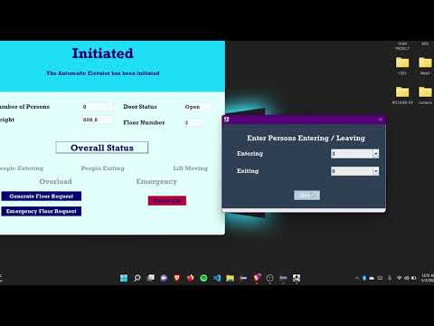
Demo Video:
SE Group 8 - Youtube

Slide 17
Submission
The complete project submission should contain the following:
SRS, SDS, Traceability matrix, PPT, Demo video
All the Java source code should necessary to compile and execute.
Specific Technology: Java, Swing, Java Mail, Java Action
Project Tasks: Use Case Analysis
Design: Class Diagram, Use Case Diagram, Traceability Matrix and Implementation, User-Interface (GUI)

Slide 18
References
https://ieeexplore.ieee.org/document/8337384
https://massivetechinterview.blogspot.com/2015/07/thought-works-object-oriented-design.html
https://www.quora.com/What-is-a-good-approach-to-answer-questions-like-design-an-elevator-control-system-using-object-oriented-principles

Slide 19
Thank You!

